Slide 1

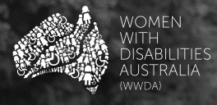
Using a holistic human rights framework to advance the rights of women and girls with disability
By Carolyn Frohmader & Karin Swift © Copyright 2016

Slide 2
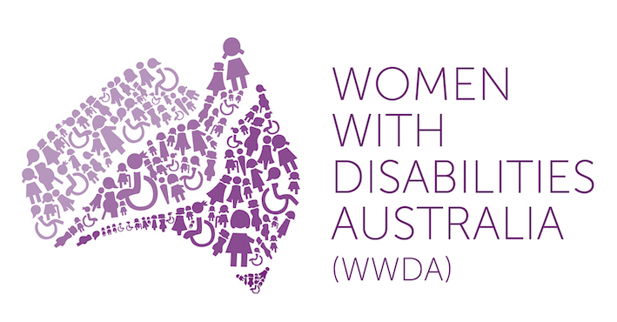
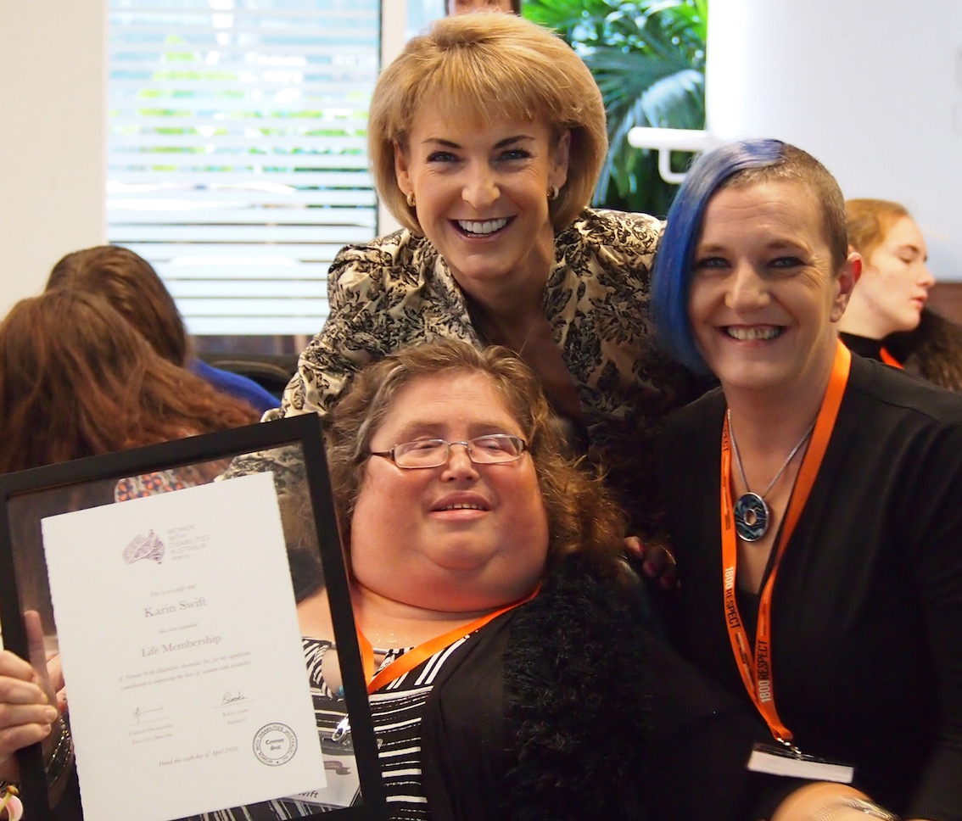
Women With Disabilities Australia (WWDA) is the award winning, national Disabled People’s Organisation (DPO) for women and girls with all types of disability in Australia. WWDA operates as a transnational human rights organisation and is run by women with disability, for women with disability.
WWDA’s work is grounded in a human rights framework which links gender and disability issues to a full range of civil, political, economic, social and cultural rights.
WWDA’s work at all levels illustrates that women and girls with disability are best positioned to identify and determine their own rights, needs, will and preferences and to make decisions concerning their circumstances and conditions.

Slide 3
Status of Women with Disability in Australia
2.1 million women and girls with disability (20% of the female population).
Experience extreme levels of all forms of violence and abuse.
Exposed to and experience egregious violations of sexual and reproductive rights including forced sterilisation, forced abortion, and forced contraception.
Subjected to unregulated or under-regulated restrictive interventions and practices.
Ten times more likely than other parents to have a child removed from their care by authorities on the basis of the mother’s disability
More than half of all women incarcerated in Australian prisons have a diagnosed psychosocial disability and a history of sexual victimisation.
More likely to live in poverty than people in the general population
Remain largely excluded from, decision-making, participation and advocacy processes.

Slide 4
How WWDA utilises a holistic human rights framework to advance the rights of women and girls with disability
1. Using the full range of International Human Rights Treaties
2. Using Treaty Body General Comments
3. Shadow Reporting
4. NGO Delegations to UN Treaty Body Compliance Reviews
5. Working with the UN Special Procedures
6. Using the UN Charter Based Bodies
7. Forming strategic alliances, building coalitions and working collaboratively
8. Monitoring Developments

Slide 5
1. Using the full range of International Human Rights Treaties to which Australia is a party
Australia is a signatory to seven core international human rights treaties, all of which create obligations to promote equality and denounce discrimination.
WWDA’s work utilises and is framed by, these seven international human rights treaties.
Implementation of these treaties is not mutually exclusive. They should be viewed and implemented as complementary mechanisms through which to advance the rights of women and girls with disability.
WWDA has made extensive use of the Convention against Torture and Other Cruel, Inhuman or Degrading Treatment or Punishment (CAT), to address sexual and reproductive rights violations (including forced sterilisation, forced abortion, and forced contraception) and other forms of violence against women with disability (such as forced ECT).
CAT mandate has clarified that medical treatments of an intrusive and irreversible nature, when lacking a therapeutic purpose, may constitute torture or ill treatment when enforced or administered without the prior, free and informed consent of the person concerned.
Notes:
These seven treaties are: Convention on the Elimination of All Forms of Racial Discrimination on 21 December 1965 ([1975] ATS 40); International Covenant on Economic, Social and Cultural Rights on 16 December 1966 ([1976] ATS 5); International Covenant on Civil and Political Rights (ICCPR) on 16 December 1966 ([1980] ATS 23); Convention on the Elimination of All Forms of Discrimination against Women on 18 December 1979 ([1983] ATS 9); Convention against Torture and Other Cruel, Inhuman or Degrading Treatment or Punishment (CAT) on 10 December 1984 ([1989] ATS 21); Convention on the Rights of the Child on 20 November 1989 ([1991] ATS 4); Convention on the Rights of Persons with Disabilities [2008, ATS 12].

Slide 6
1. Using the full range of International Human Rights Treaties to which Australia is a party
WWDA participates in the work of the CAT Committee and the work of the UN Special Rapporteur on Torture:
  provision of Shadow Reports;
  regularly provide copies of WWDA publications, letters,
  member of the NGO delegation to the CAT Review of Australia;
  met directly with individual Committee members;
  lodging of formal complaint to Special Rapporteur regarding forced sterilisation in Australia;
  providing draft Concluding observations;
  Provision of Fact Sheets and lobbying materials
Concluding Observations from the CAT Review of Australia in 2014, subsequently included strong and specific recommendations relating to violence against women with disability and forced sterilisation.

Slide 7
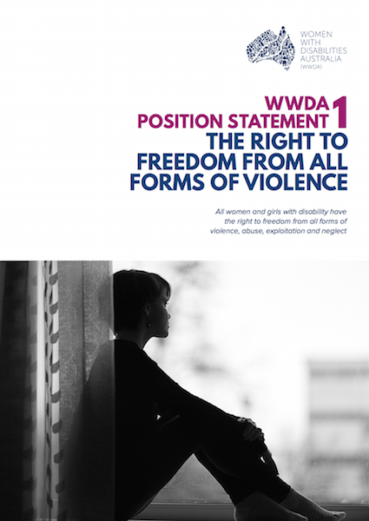
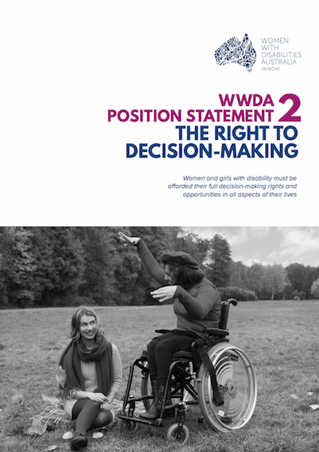
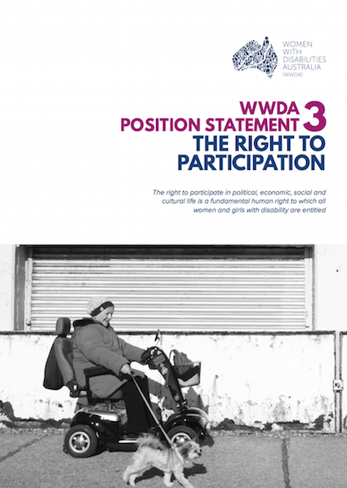
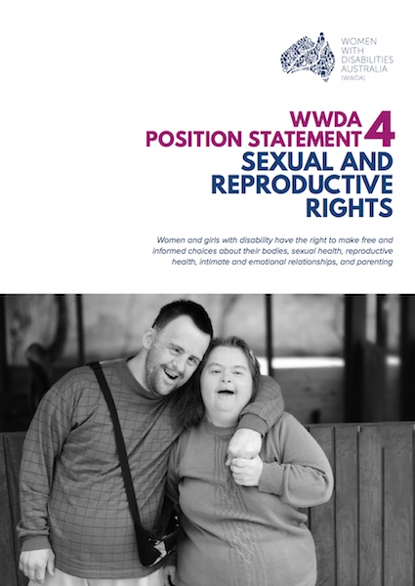
2. Using Treaty Body General Comments
General Comments form a vitally important component of a States treaty obligations and compliance.
Assist non-government stakeholders as well as Governments in understanding treaty provisions and in strengthening national advocacy.
In late 2016, WWDA developed a series of comprehensive WWDA Position Statements on key human rights issues identified by women and girls with disability. Position Statements make extensive use of several General Comments to articulate in detail, Australia’s obligations under the international human rights treaties to which Australia is a party.

Slide 8
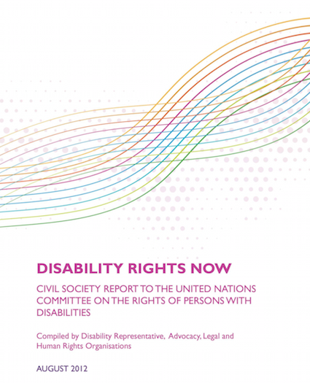
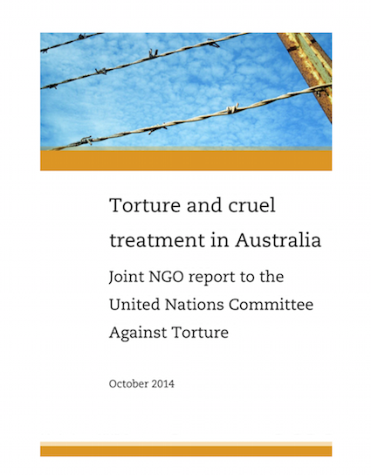
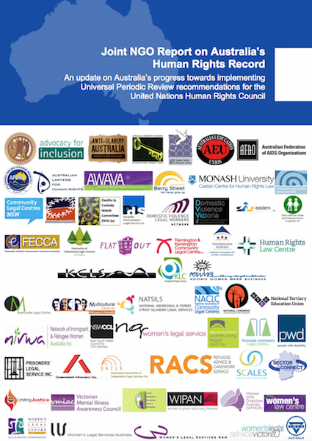
3. Shadow Reporting
WWDA contributes formal stand alone Shadow Reports in our own right, particularly to CEDAW, CRPD and CAT.
WWDA also works as an active member of national NGO/Civil Society Coalitions established specifically for the purpose of developing Shadow Reports to supplement the Australian Government periodic reports to the relevant treaty-monitoring bodies.

Slide 9
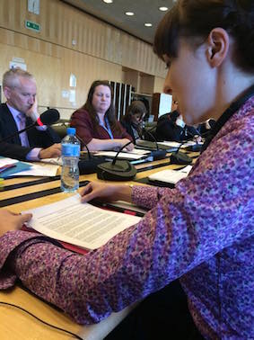
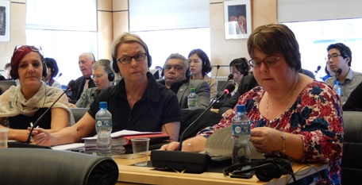
4. NGO Delegations to UN Treaty Body Compliance Reviews
Presence, visibility and active engagement of women with disability at formal UN treaty body compliance reviews of States Parties is critical
Women with disability must be included in NGO/civil society delegations
WWDA has had particular influence when we have been an active member of NGO/civil society delegations – lobbying, meeting with treaty body Committee members, giving formal presentations to Committees, assisting in drafting Concluding Observations/Recommendations

Slide 10
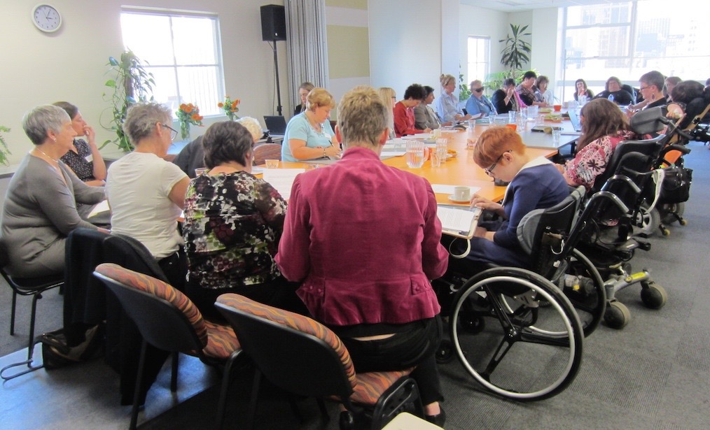
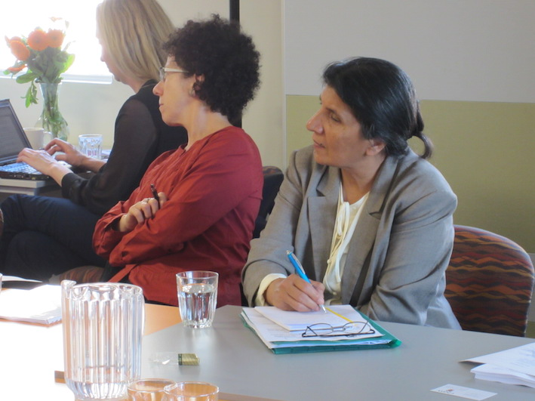
5. Working with the UN Special Procedures
WWDA routinely and regularly engages with the UN Special Rapporteurs by providing them with our reports, research, articles, case studies, as well as participating in and contributing to, the work of the Special Rapporteurs.
In 2011, WWDA lodged a formal complaint with four of the UN Special Rapporteurs, regarding forced sterilisation. This complaint led to the establishment of the Australian Senate ‘Inquiry into the involuntary or coerced sterilisation of people with disabilities in Australia’, conducted in 2012.
In 2012 the Special Rapporteur on Violence Against Women visited Australia. WWDA organised a Roundtable of Women with Disability where the SR met with women with disability to discuss violence against women with disability.

Slide 11
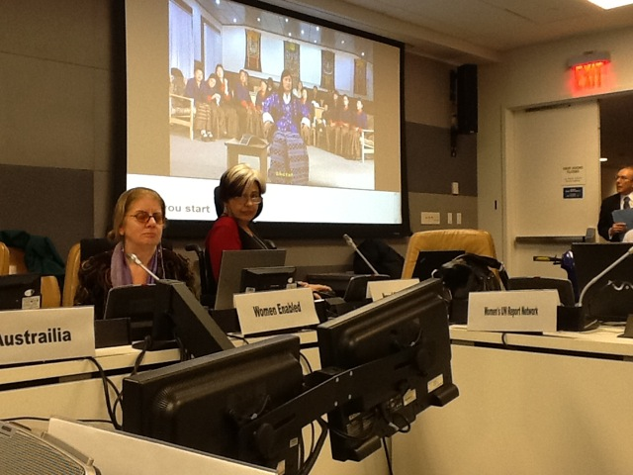
6. Using the UN Charter Based Bodies
WWDA’s work also includes engaging with and participating in UN Charter based bodies, such as the UN Commission on the Status of Women (CSW). WWDA was fortunate to be represented at CSW in 2012, 2013, 2014 and 2015.
Visibility of WWDA and our sister colleagues at CSW has seen more emphasis given to women with disability in the Agreed Conclusions stemming from sessions of CSW.
WWDA has co-hosted and co-sponsored Side Events at CSW, including a High Level Panel on Rural Women and Girls with Disabilities at the 56th session.

Slide 12
7. Forming strategic alliances, building coalitions and working collaboratively
WWDA recognises that mutually beneficial relationships achieve outcomes that extend beyond what WWDA can achieve in isolation.
WWDA is a founding member of Disabled People’s Organisations Australia (DPOA) – a new and innovative alliance of four national DPO’s in Australia. Works on joint initiatives:
  DPOA delegation to the CRPD COSP in June 2016;
  DPOA Federal Election Platform Campaign;
  DPOA campaign which led to the Senate Inquiry into Violence against people with disability in institutional and residential settings
WWDA collaborating with the United Nations Population Fund (UNFPA) to establish and implement four-year global program to improve the human rights of young people with disability worldwide
WWDA working in partnership with private sector company called Medibank Health Solutions to improve accessibility of the national 24-hour telephone and online counselling, information and referral service (called 1800RESPECT)

Slide 13
8. Monitoring Developments
Through our extensive networks, alliances and collaborative relationships, we work hard to keep abreast of developments occurring in relation to the rights of women and girls with disability.
Monitoring the outcomes of other countries UN reporting processes enables us to use these developments in our own advocacy work. This assists WWDA in building the evidence base around the widespread infringements of the rights of women and girls with disability, and importantly, places our work firmly in a globalised context.

Slide 14
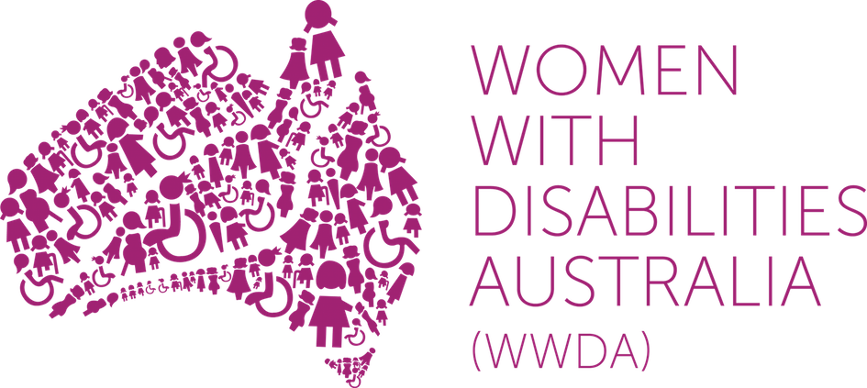
Winner, National Human Rights Award 2001
Winner, National Violence Prevention Award 1999
Winner, Tasmanian Women's Safety Award 2008
Certificate of Merit, Australian Crime & Violence Prevention Awards 2008
Nominee, French Republic's Human Rights Prize 2003
Nominee, UN Millennium Peace Prize for Women 2000
PO Box 407, Lenah Valley TASMANIA 7008 AUSTRALIA
Ph: +61 438 535 123
E: carolyn@wwda.org.au W: www.wwda.org.au
FB: www.facebook.com/WWDA.Australia
Twitter: https://twitter.com/WWDA_AU
Contact: Carolyn Frohmader (Executive Director)
© Copyright 2016. Women With Disabilities Australia (WWDA) Inc.

